Slide 1
Periodic Trends- Atomic Radius

Slide 2
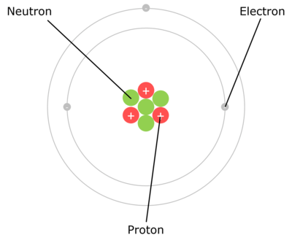
In this Smart Lesson you will learn:
• | What we can determine about the electron configuration of an element based on its location in the periodic table.
• | About a property of an atom called the atomic radius.
• | How the atomic radius differs between elements and the trend it follows across and down the periodic table.

Slide 3
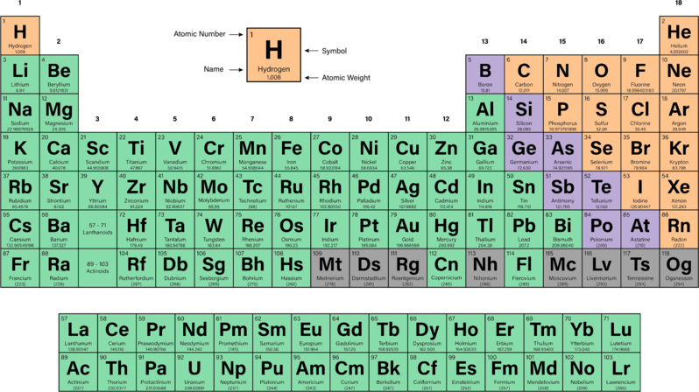
While the periodic table is organised in order of increasing atomic number several trends and groupings are the result of electronic configuration.

Slide 4
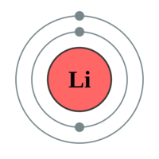
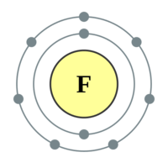
Each element in a period (horizontal row) of the periodic table has its valence electrons in the same energy level.
For example consider the second period elements lithium and fluorine, which both have two electron shells:

Slide 5
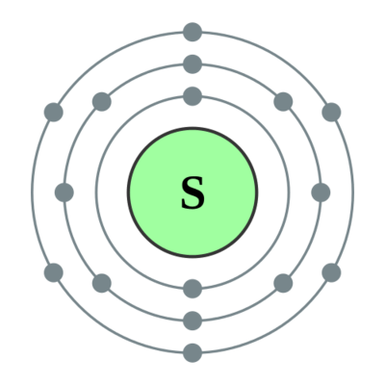
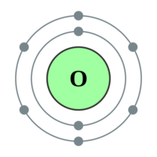
Each element in a group (vertical column) of the periodic table has the same number of valence electrons, (number of electrons in the outer shell).
For example consider the group 16 elements oxygen and sulfur which both have 6 valence electrons:

Slide 6
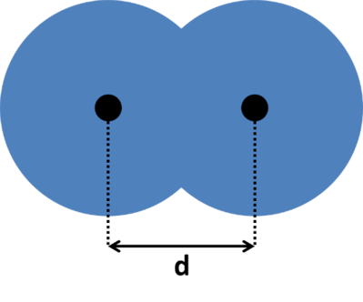
The atomic radius is a measure of the radius of a single atom and varies between elements.
It is often measured as half the shortest distance between two atoms in a homonuclear diatomic molecule (a molecule made up of only two atoms of the same element). In the diagram this would be ½ d.
For example, if we wished to measure the atomic radius of an oxygen atom we would examine the diatomic compound O₂​. The atomic radius in this case would be half the bond length between the oxygen atoms.

Slide 7
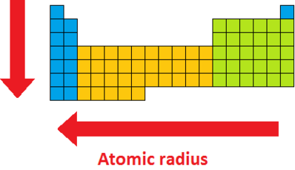
The width of atoms, measured as the atomic radius, tends to increase going down the periodic table but decrease with increasing group number. The atoms with the largest atomic radii are located at the bottom-left of the periodic table.
This is because as the period number increases the number of electron shells an element has also increases. As the group number increases elements have more protons, as such the attraction between the electrons and the nucleus increases so the electrons move closer.

Slide 8
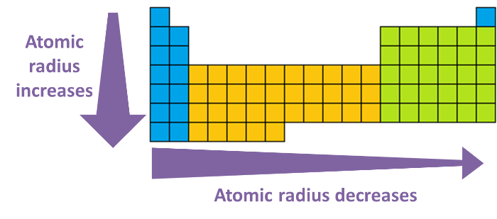
The atomic radius tends to increase going down a group and decrease across a period. The atoms with the largest atomic radii are located at the bottom-left of the periodic table (i.e. Fr).
When we go down a group, the number of electron shells increases, which of course dramatically increases the atomic radius.
When we go across a period elements gain more protons, which increases the attraction between the negatively charged electrons and the positively charged nucleus. This means the electrons are pulled closer to the nucleus and therefore atomic radius decreases.

Slide 9
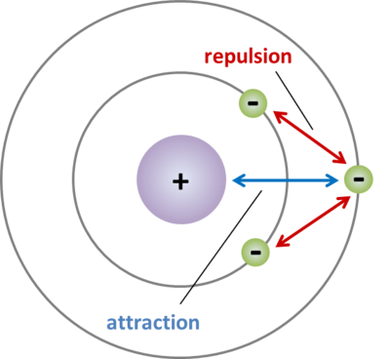
When comparing elements in different periods, it is important to consider electron shielding (or screening) which influences the atomic radius and many other atomic characteristics.
Electron shielding occurs in any atom with more than one electron shell. It is where electrons in inner orbitals shield valence electrons from the nucleus.
The electrons in the outer shells are attracted to the positively charged nucleus, but they are also repelled by the negatively charged electrons in the inner shells. This repulsion reduces the electrostatic attraction between the nucleus and the valence electrons. The valence electrons are therefore less tightly held to the nucleus, making the atomic radius larger.
Note: Electron shielding does not affect atomic radii across a period. This is because electrons are added to the same electron shell going across a period, so there are the same number of electrons in the inner shells for each element in a period.

Slide 10
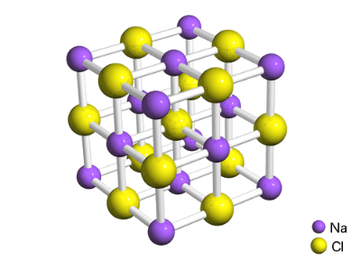
Similar to the atomic radius, the ionic radius is a measure of the radius of a single ion. The ionic radius is calculated using measurements from ionic crystals, which are crystals containing a lattice of ions such as sodium chloride.
X-ray crystallography can be used to measure the distance between the ions in a crystal lattice; for example, in sodium chloride the distance between Na+ and Cl− ions is 282 picometres. However, it does not indicate where the boundary is between the two ions, so it doesn't give ionic radii directly. Various methods were devised to determine the actual ionic radii by scientists including Landé, Pauling and Shannon. You do not need to know the exact methods for determining ionic radii.

Slide 11
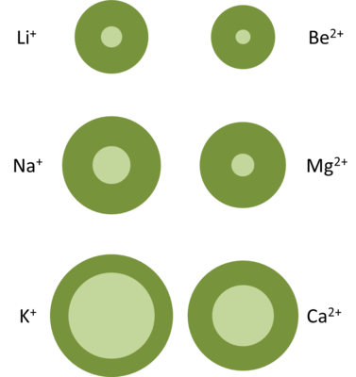
What you do need to know is that cations (positive ions formed by losing electrons) generally have a smaller ionic radius than the atomic radius of the neutral atom.
Elements in groups 1, 2 and 3 lose their entire valence electron shell when they form cations, and thus the ionic radius of the cation is much smaller than the atomic radius. (Right: Dark green indicates atomic radius and light green indicates ionic radius.)
Elements in groups 4−15 form cations without losing their valence electron shell. However, they still have an ionic radius that is smaller than the atomic radius because the electrostatic attraction between the nucleus and the electrons increases. There are now fewer valence electrons than in the neutral atom which means there is less repulsion between these electrons, and the remaining electrons are being pulled in by the same number of protons as were in the neutral atom.

Slide 12
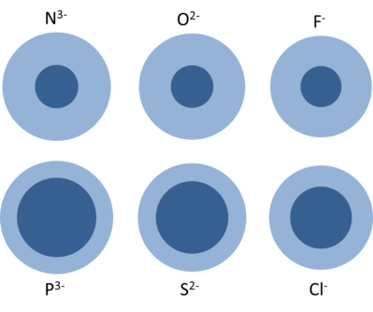
In general, anions (negative ions formed by gaining electrons) have a larger ionic radius than the atomic radius of the neutral atom.
Gaining extra electrons means there is greater repulsion between the electrons in the valence shell, which increases the ionic radius. Also, the electrostatic attraction slightly decreases, because now there are more electrons than protons, so the nucleus cannot pull the negatively charged electrons in as effectively.
Dark blue indicates the atomic radius and light blue indicates the ionic radius of the anion.

